Slide 1

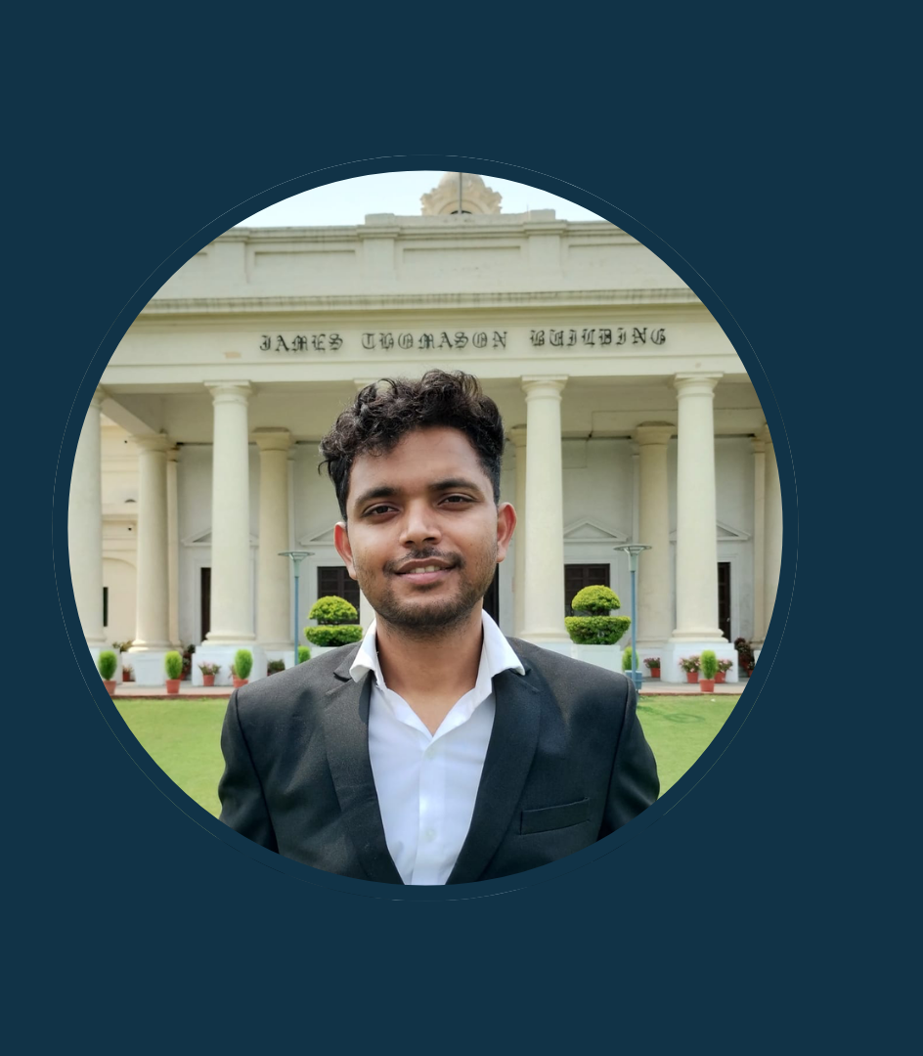

Unleashing the Power of
Gemini Multimodal
Aman Kumar
Google Cloud Platform Corporate Trainer
Credits: https://www.cloudskillsboost.google/
Notes:
**(Keep it short and sweet, prioritize clear attribution)**
**Speaker Note:** "This slide uses materials from Google Cloud Skills Boost. Full credit and access to their resources are available at the linked URL."

Slide 2

Introduction to Multimodal AI
Core Capabilities of Google’s Multimodal AI-Gemini
Prompt Engineering Basics
How to access these Models
Agenda
Credits: https://www.cloudskillsboost.google/
Notes:
Okay, here's a concise and professional speaker note for the slide:
**Speaker Note:**
"This slide outlines our agenda for today. We'll start with an introduction to Multimodal AI, then delve into Google's Gemini. I'll cover its core capabilities, followed by prompt engineering basics and how to access these models. Finally, a quick acknowledgement of the training resources at Cloud Skills Boost. Let's dive in!"

Slide 3
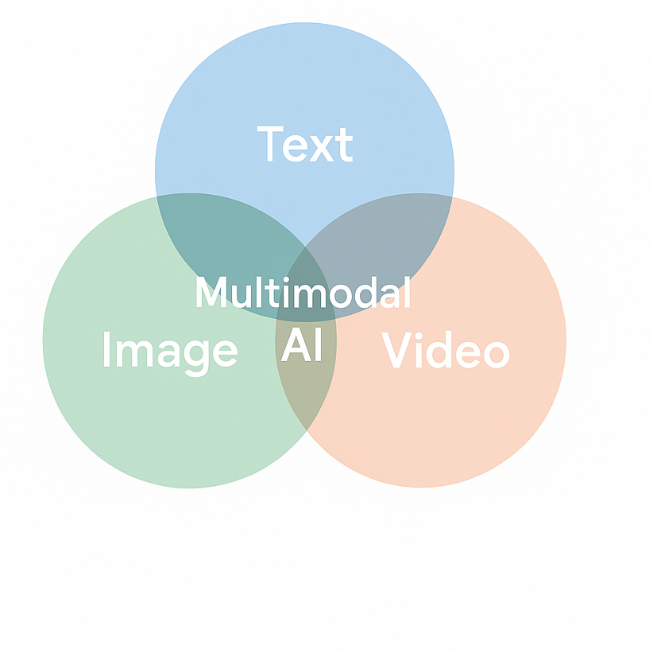
What are Multimodal AIs?
What is Multimodal AI? Ability to process and understand multiple data types—text, images, and video in a unified model.
Why It Matters? Just as humans combine sight, sound, and language to perceive the world, multimodal AI brings richer context and deeper insights.
Everyday Examples:
Describing the contents of an image in sentence
Generating video caption
Summarizing a multimedia presentation
Credits - https://www.cloudskillsboost.google/
Credits: https://www.cloudskillsboost.google/
Notes:
**Slide Title: Multimodal AI: Understanding & Applications**
**Speaker Notes:**
* **(Introduce Slide)** This slide defines multimodal AI and highlights its importance.
* **(Define)** Multimodal AI processes different data types like text, images, and video simultaneously. Think of it as a unified model understanding multiple senses.
* **(Explain Importance)** This allows for richer context and deeper insights, mirroring how humans perceive the world using multiple senses.
* **(Examples)** Everyday applications include describing image contents, generating video captions, and summarizing multimedia presentations. This reflects the versatility of this technology.
* **(Credit)** The information presented is sourced from Cloud Skills Boost by Google.

Slide 4
Core Capabilities of Gemini
Natively Multimodal Processes and understands diverse data types—text, images, video, and audio—in a unified model.
Advanced Reasoning & Contextual Understanding Excels at tasks requiring logic, contextual knowledge, and multi-step reasoning.
Seamless Modality Transitions Interprets prompts that span formats—such as generating text descriptions from videos or answering questions about images.
Integration with Latest Generative Models Leverages cutting-edge models like Veo 3 and Imagen 4 for enhanced media generation capabilities.
Credits - https://www.cloudskillsboost.google/
Credits: https://www.cloudskillsboost.google/
Notes:
**Slide Title: Core Capabilities of Gemini**
**Speaker Note:**
* Highlight Gemini's core strengths: Native multimodality, advanced reasoning, seamless modality transitions, and integration with advanced generative models.
* Briefly explain each capability with a simple example: (e.g., "Gemini can understand both text and images together, allowing you to ask questions about the content of a picture.").
* Emphasize the unified model aspect of multimodality.
* Acknowledge the source: "This information is based on publicly available information from Google Cloud Skills Boost."

Slide 5
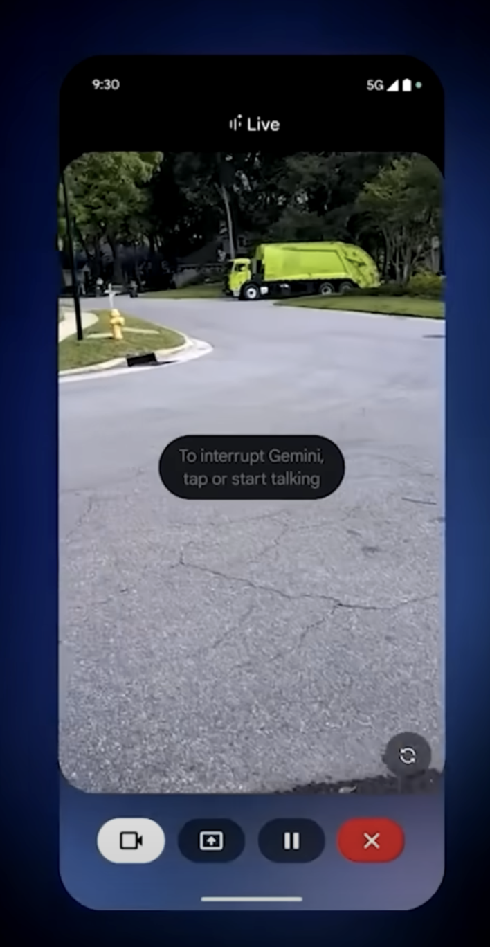
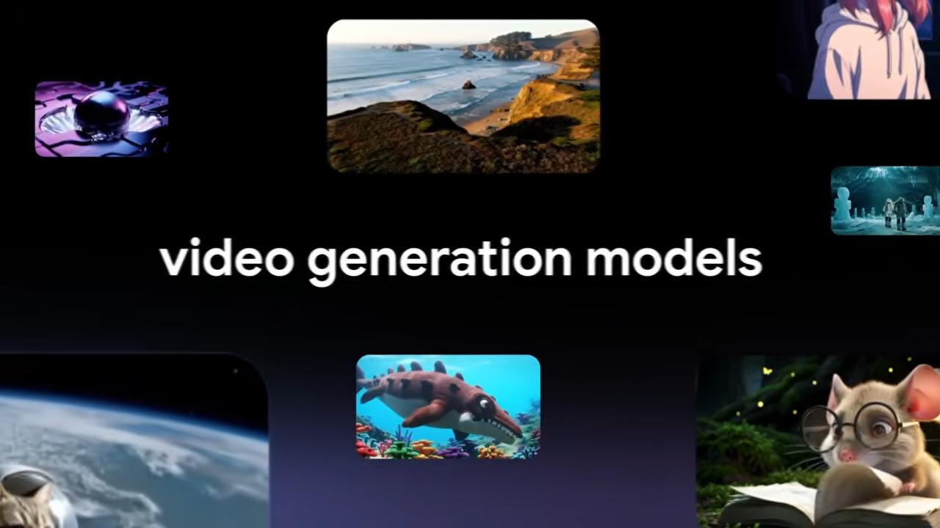
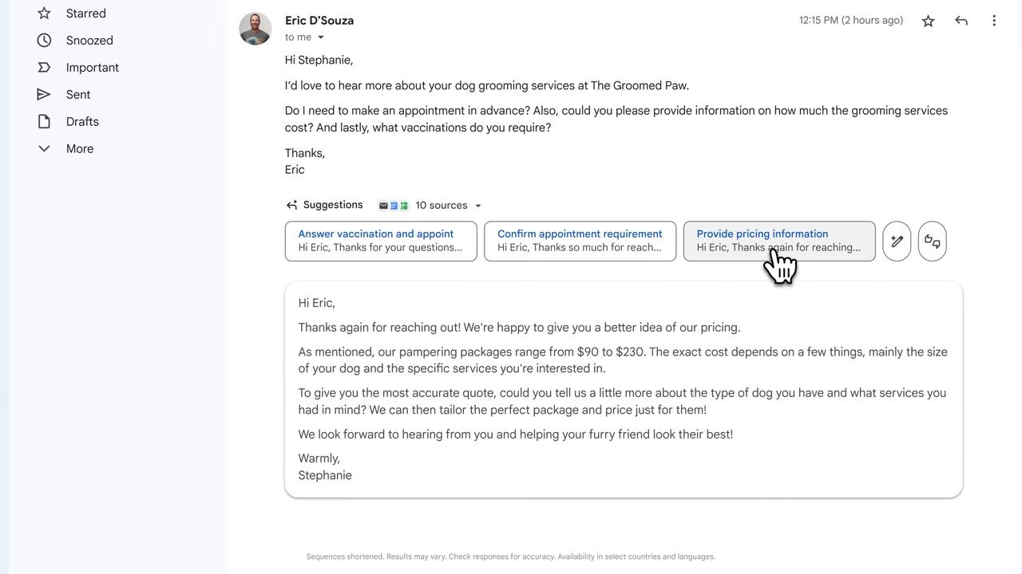
Advanced Capabilities of Gemini
Credits - https://www.cloudskillsboost.google/
Credits: https://www.cloudskillsboost.google/
Notes:
Okay, here are a few options for speaker notes, ranging from minimal to slightly more detailed, depending on your needs:
**Option 1 (Minimal - Assumes audience familiarity):**
> Briefly highlight the advanced capabilities showcased on the previous slides. Acknowledge Cloud Skills Boost as the source of these insights and examples; these links are for further learning.
**Option 2 (Slightly More Detailed - Briefly explains Gemini):**
> Recap the advanced capabilities of Gemini, emphasizing how it goes beyond simple tasks. Cloud Skills Boost is our source for the content on these capabilities. Refer to the linked resources for in-depth tutorials and use cases.
**Option 3 (Most Detailed - Good for introductory presentations):**
> This slide acknowledges the source for the information regarding Gemini's advanced capabilities. Gemini is Google's family of generative AI models. The examples provided in the previous slides were informed by resources on Cloud Skills Boost. Please visit the provided link for further hands-on labs and detailed documentation. This information will allow us to further explore the different advanced Gemini features.
**Key Considerations for Choosing:**
* **Audience Knowledge:** How familiar is your audience with Gemini and Cloud Skills Boost?
* **Presentation Flow:** Does this slide serve as a quick acknowledgement, or a springboard for deeper discussion?
* **Time Constraints:** How much time do you have to speak about this slide?
I would personally lean towards **Option 2** as a good balance between brevity and clarity. Remember to adjust the note to best fit the specific content of the *preceding* slides. Good luck with your presentation!

Slide 6

Prompt Engineering
The art of crafting effective instructions that guide the AI to generate accurate, useful, or creative responses.
Credits - https://www.cloudskillsboost.google/
Credits: https://www.cloudskillsboost.google/
Notes:
**Speaker Note:**
This slide introduces prompt engineering. Explain it's about crafting precise and effective instructions to elicit desired responses from AI models. Emphasize the importance of well-designed prompts for accuracy, usefulness, and creativity. Source credit: Cloud Skills Boost.

Slide 7
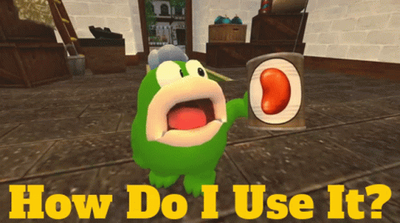
How to Access Gemini-MultiModal?
Gemini AI Website and Application
Google AI Studio
Vertex AI Studio for developers
Credits - https://www.cloudskillsboost.google/
Credits: https://www.cloudskillsboost.google/
Notes:
Okay, here's a concise and professional speaker note for that slide:
**Speaker Note:**
"This slide outlines the primary methods for accessing Gemini-MultiModal. You can explore its capabilities through the Gemini AI website and application, Google AI Studio for experimentation, and Vertex AI Studio for developer integration. The training and resources used in this presentation are credited to Google Cloud Skills Boost. Refer to the provided link for further learning and documentation."

Slide 8
Difference between Google AI Studio and Vertex AI Studio
Choose Google Al Studio If:
You are in the initial stages of testing different AI models, features and techniques.
You are exploring consumer or hobbyist use-cases that don't require enterprise data protections.
You seek a free and user-friendly platform for experimentation.
You are rapidly prototyping and testing prompts.
Choose Vertex Al Studio If:
You are looking to deploy and scale AI solutions to multiple users.
Enterprise-grade security and compliance are essential for your use-case.
Customization and fine-tuning of AI models using a variety of techniques is crucial for your project.
You're looking to use speech-to-text, text-to-speech, and text-to-image models.
Credits - https://www.cloudskillsboost.google/
Credits: https://www.cloudskillsboost.google/
Notes:
**Speaker Note:**
"This slide highlights the key differences between Google AI Studio and Vertex AI Studio to help you choose the right platform. Think of AI Studio as your rapid prototyping and experimentation sandbox – ideal for testing models and prompts for personal or hobbyist projects. Vertex AI Studio, on the other hand, is your enterprise-ready platform for deploying, scaling, and customizing AI solutions with robust security, compliance, and advanced functionalities like speech and image models. Consider your project's requirements carefully to determine which platform best suits your needs. Credit to Google Cloud Skills Boost for the information presented here. "

Slide 9


Feel free to send in any questions
to info@koenig-solutions.com.
Credits: https://www.cloudskillsboost.google/
Notes:
Okay, here's a concise and professional speaker note for that slide:
**Speaker Note:**
* "We're happy to answer any questions you might have. Please feel free to email them to info@koenig-solutions.com. Also, a thank you to Google Cloud Skills Boost for the resources used in this presentation."

